Slide 1

Closing The Feedback Loop: Unblock Your Agile/DevOps Transformation
Esteban Garcia & Heidi Araya
New Signature/Tenable
Level: Intermediate
Notes:
Add message for each person – what we want to convey
Use stories where possible

Slide 2
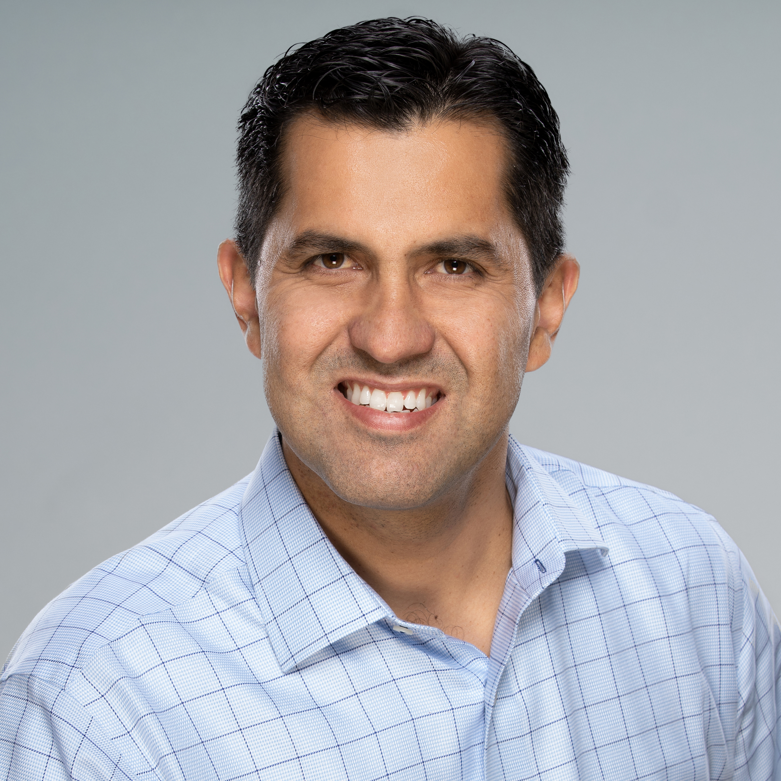

Why am I here?
@EstebanFGarcia
@HeidiAraya
Notes:
Esteban -
Heidi – People are getting agile transformations very wrong. It's not about sprints and daily scrums. It is about enabling the business to respond to change. I'm here to share that the practices should be a result of the mindset and culture of wanting to continuously improve..., it does not result from rigidly following an imposed practice, which is not agile at all.

Slide 3

We have a problem!
Our competition is releasing more features faster
Stealing our customers
And actually delivering features customers want!
Notes:
Esteban: We were cutting edge at one point, and we stopped innovating. Aging software and process + complacency from the business were part of the reason why we got here. The business is now in panic, they want us to fix this now. We are losing market share very fast and there’s no end in sight.
Heidi: the competitor is often more nimble because they don't have the legacy processes in place to slow them down.

Slide 4

We need to go faster!
Let’s do "Scrum" and "Sprints"…
We need CI/CD and DevOps stuff!
Let’s just get rid of QA!
Finally, a plan! Hire consultants and buy all the tools ...
Notes:
Heidi: people think that Agile is about faster, better, cheaper – so they think Scrum will get them efficiency quickly .
Esteban: We are “doing all we can”, we are adding more and more story points to our sprints, and our team is working overtime to complete those story points. Stories are piling on and stuck in dev and in various branches, while we wait to get them into a release. When we try to release a new story, we realize that we have to backout another and all this cherrypicking makes our releases even more complex and causes us to battle with bad deployments.
Heidi – companies also often fire QA after doing the first two things and tell teams to own their own quality....

Slide 5


... Nine months later…
Tools
Scrum
Automation
Notes:
Esteban – We implemented all the things that the books and Google searches told us would fix the problem. We bought the most expensive tools that we found,
Heidi - we trained everyone in Scrum (we even have the certificate to prove it),
Esteban - and we started automating all the testing that QA used to do. Our Selenium test project is huge, we are really proud of the fact that we have automated tests for a lot of our UI, and it only takes 14 hours to run and those tests cover 9% of our code!

Slide 6

We (still) have a problem!
Our competition is releasing more features faster
Stealing our customers
And still delivering features customers want!
On top of that, we’ve wasted time and money
Consultants, tools, training...
Notes:
Heidi
Executives are nervous.
Our customers now mention our competition by name when not renewing their contracts.
Teams are frustrated … and our senior engineers are leaving.
The consultants we hired are gone, and people are confused why things seem worse than before...
Esteban
The decisions were well-intentioned, but the results were not what the company expected. Throwing money and tools at the problem does not create long-lasting and impactful results.
It may solve a short-term problem, create a temporary band aid, but it typically does not get to the root of the problem

Slide 7

Now quality is suffering!
We only automated UI
Teams are interrupted
Quality issues
Production support
​But… no real way to measure quality​
Notes:
Heidi - Customer support staff are frustrated... tickets are stacking up, and SLAs are not being met. Sales staff are angry -- Teams cannot crank out those new features they promised last quarter!
We know quality is down, but we can't really say how much it's decreased... only that people in general are unhappier.

Slide 8

What Now??

Slide 9

Pause & Identify the Challenges
Hold a group discussion to identify top challenges
Where do we want to be?
What is stopping us from getting there?
Create a backlog and prioritize problems to be solved
Notes:
Heidi: hold a retrospective and identify what's stopping you, or slowing you down? Be sure to engage the people who are closest to the actual problems have the most input.
Create a backlog of the problems to be solved and prioritize them by most impatfu

Slide 10
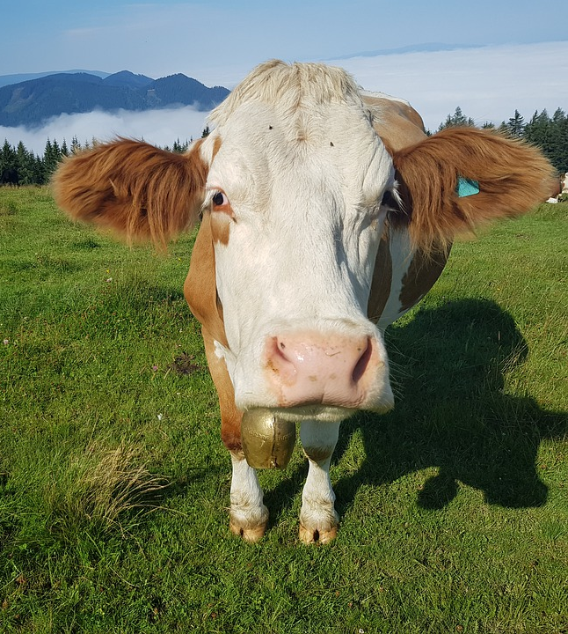
Address the Challenges
Identify outcomes, not just output
What improved outcome will you expect?
How will you enable this outcome to happen?
Try top 1-2 things, not more...
Quick wins & most impactful
Notes:
Esteban; outcomes are the capabilities you did not have before... and why you want them.. These are the things that pay off in the long run: invest in identifying the outcomes that will make you successful, and creating a path to get there.
Heidi: Lean and Agile are based on focusing on what's most important/impactful, not trying to do everything. Focus on the top one-two things and move those along, If you try everything, you won't make much progress on anything.

Slide 11

Strive for Continuous Improvement
Constant learning – regular reflection on your progress
Inspect and adapt along the way...
Notes:
Esteban; outcomes
Heidi: Agility is based on the idea of continuous learning.

Slide 12

Challenges We've Seen

Slide 13

Process Challenges
Manual steps in deployment
Tools don’t integrate
Formal reviews too late in the process (code, security, design)
Is anyone using the latest features?
Notes:
Esteban... Many times, the first place that companies turn to is tools. You have a problem? Let's go buy a tool to solve that problem. And then, you have to integrate it with all the other tools that you bought. And now you find yourself changing your process to fit the way that tools work.
Rather than finding ways to automated early, teams wait too long to automate and that typically results in complex processes and that sometimes leads to resistance to change because "automating this complex process is just not possible"
And we get in this mode of coding coding and coding for so long, and we wait way too long to have a formal review. And then we wait even longer to do a security review. And then comes the enterprise architect to provide their final rubber stamp before going live. We are missing valuable opportunities for review earlier in the process.
Heidi – if Agile is about feedback, we have failed. We aren't listening to customers or even demoing the features internally. We are just trying to catch up to the competition …..

Slide 14

Team challenges
Silos
Operations team owns deployments
Lack of shared priorities
Notes:
Esteban
Examples: Dev & QA. Dev & Ops. Release Management/"DevOps". Infrastructure. Prod support. SRE
How are teams compensated/rewarded? It is important to be aligned, otherwise, we are operating with different rules and motivations.

Slide 15

Environment Challenges
Lack of test environments
No access to test data
Manual processes & bottlenecks
Notes:
Esteban: talk about the importance of practicing deployments and having a stable environment to run tests in a production-like environment. Also talk about compliance and securing data – we don't want real production data in non-production environments.

Slide 16

Culture Challenges
All this work and no real benefits
Culture feels "worse"
Unhappy teams
Employee engagement lower
Notes:
Heidi
Cannot fix culture with process.
Culture is the sum of all our daily interactions & what behaviors we reward
Why are unhappy teams something we need to worry about?

Slide 17
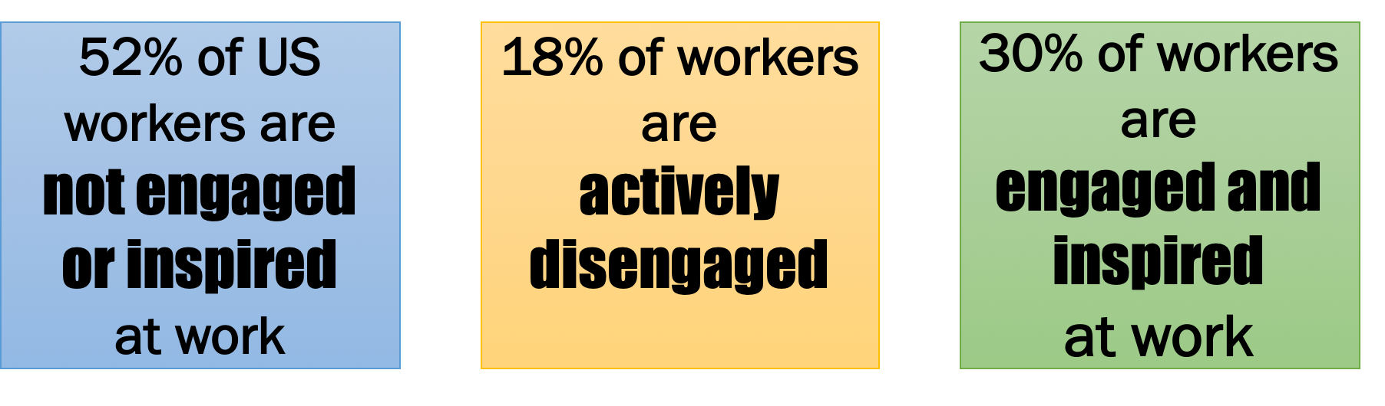
70% of Workers are Disengaged!
Notes:
These statistics are stunning. I could spend a whole hour talking about why people are disengaged, but that's not for this talk. People want autonomy, mastery, and purpose at work, along with clarity in their work and feeling they are making a difference .

Slide 18

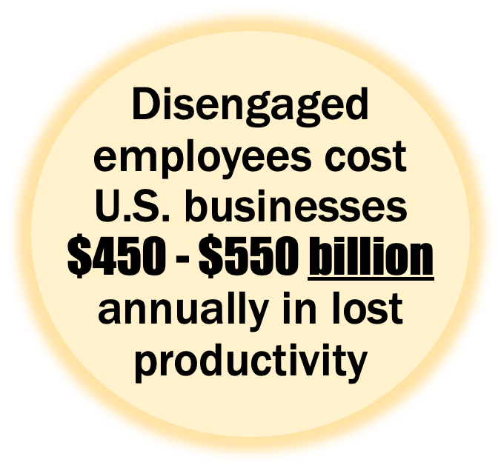
Disengaged Employees...
Notes:
Heidi
Unhappy people are less productive. Yet another study came out of the UK recently reaffirming that happy people are more productive.
if your employees are not engaged, they will likely go off and start working for your competitor - taking all their knowledge with them, and helping the competition.

Slide 19
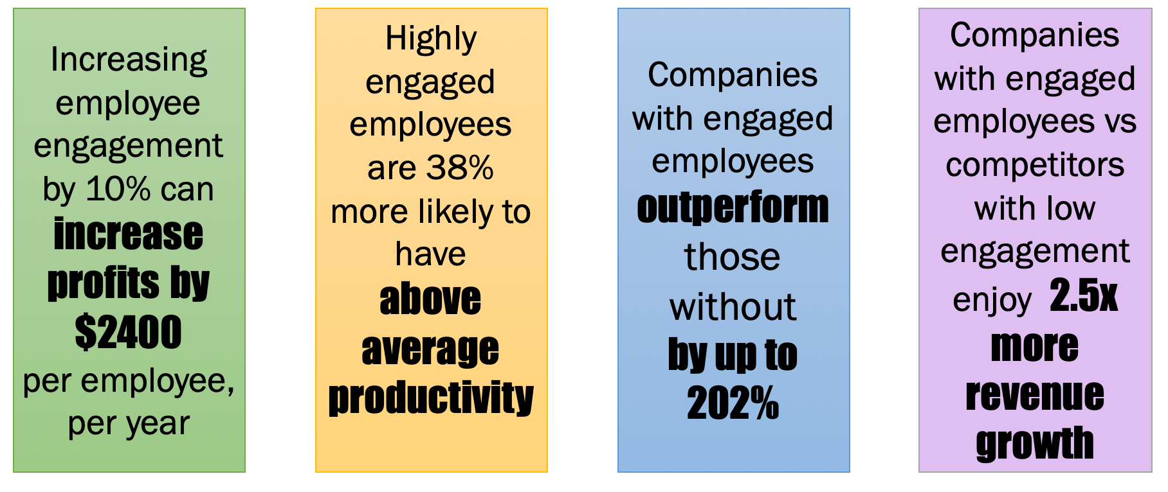
Engagement: a competitive advantage
Notes:
https://recruitloop.com/blog/much-can-disengaged-employees-cost-business-infographic/
Highly engaged employees are also 87% less likely to leave the company they work for than their counterparts … and they will go wok for the competition.

Slide 20

Increase engagement and business results
by focusing on capabilities & improving feedback loops

Slide 21

DevOps Capabilities
Continuous Delivery
Architecture
Product & Process
Lean Management
Culture
Notes:
Talk about the book here
Esteban: Accelerate is an amazing book that gives us a scientific look at the metrics that matter for DevOps. This book was written by the same person that puts out the yearly State of DevOps report. In the book, Dr Forsgren shares with us her research of what makes teams high performant, which are the capabilities that have proven to be keys for success. She helps us understand the metrics that are important, and which metrics are there purely for vanity reasons. More importantly, she talks about how each metric is related to others and how to improve each metric in a way that is not just focus in out output through maturity level, but rather on an outcome by enablig capabilities for success.
The book is required reading at my organization for people in my team.
Heidi: so many people have metrics that do not mean anything. Luckily, this book has some ideas about which metrics could be important to your organization's agility. Throw in meaningless metrics … story points committed versus delivered, team burndown, # of bugs found, eetc

Slide 22

Continuous Delivery
Use version control
Automate deployment process
Continuous integration
Trunk-based development
Implement test automation
Test data management
Shift left on security
Continuous delivery
Notes:
Esteban – Shipping is a feature
Definition of done: Live in production, collecting telemetry, supporting or diminishing the starting hypothesis
Heidi – we can't do automated deployments on the agile teams because compliance
Secure coding practices – trained people – and other enablement

Slide 23

Architecture
Loosely coupled
Architect for empowered teams
Notes:
If you are trying to go faster but have a big monolith, you have to do a full regression test, -- this is not scalable for frequent releases... so you have to start breaking things up
Heidi: Spotify model often employed without understanding the problem they were trying to solve! Not all systems can easily be loosely coupled – dig deep and solve the biggest problems first. E.g., If you have teams "owning" services or code... pause and ask what is holding you back? What's in your way from having empowered teams?

Slide 24

Product
Gather & implement customer feedback
Instrumentation
Enable team to experiment with product features
Notes:
Heidi – pushing to deliver new features quarter over quarter

Slide 25

Process
Make the flow of work visible
Work in small batches
Enable team experimentation with process

Slide 26

Lean Management
Lightweight change approval process
Monitor across application & infrastructure to inform business decisions
Check system health proactively
Visualize work and monitor quality
Improve processes & manage WIP
Notes:
Esteban to make the point that this and the next slide are the most challenging parts of your company’s transformation. Talk about the person that slows down the process by 3 days when it gets to them.
Heidi: if you do not do this, all the rest will make little difference .
Monitor across application & infrastructure to inform business decisions: instrument your code and know how the features are being used
Check system health proactively: health starts at the backlog through production (and back)
Heidi – move the decisions closest to the team
No more gut decisions
Don't blindly follow process
Knowledge work is invisible, so visualizing it is key to improving processes

Slide 27

Culture
Know what makes work meaningful for you and your team
Environment of high cooperation and trust
Support a learning culture
Promote collaboration across teams
Support & encourage inclusive leadership
Transparent flow of information
Conscious inquiry & acceptance of diverse opinions
Notes:
Heidi; -- culture seems like a lot of hand wavey stuff, but is one of the most important things to keeping employees engaged, and I alraedy shared how important that is!
Heidi; none of this is possible without a supportive culture. Psychological safety
Is everyone's voice heard?
Autonomy mastery purpose

Slide 28

Agility is enabled through lean management & a generative culture
...which also increases engagement ​
Notes:
You cannot separate the culture and lean management from 'delivery'

Slide 29
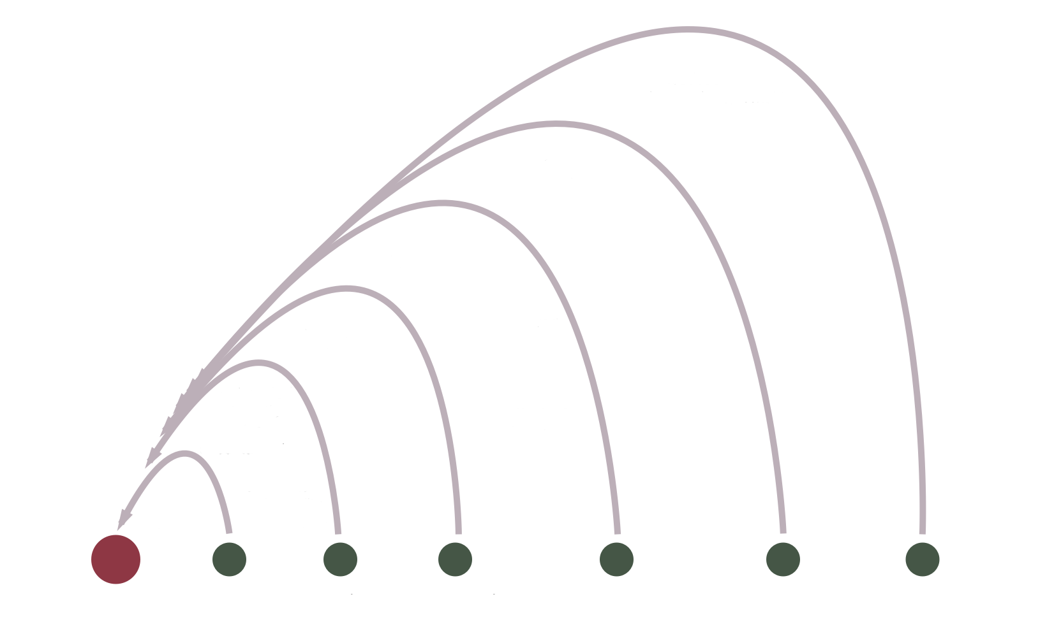
Enable Multiple Feedback Loops
User Feedback
System Health
Validation Across Environments
Automated Functional Test
Continuous Integration
Pull Request
Notes:
Enabling feedback loops is not so simple. You will need cultural and lean enablers.

Slide 30

Pull Request Feedback Loops
How do we get there?
Version Control
Work in small batches
Lightweight change approval process
Cultural & Lean Enablers
Single, meaningful list of priorities
Find and measure bottlenecks
What is the team now capable of?
Build and measure application health early and often
Provide & receive feedback on solutions earlier than before
Notes:
Be prepared to share some strategies on how to work through problems that would be created when introducing PRs – such as team lead being a bottleneck, using PRs to manually check for naming conventions, coding standards. Use this as a learning opportunity.
Heidi – oh, you think it's that easy, huh? Well, imagine we have a bunch of teams, and not everyone can review the code in the PRs. We have a lead engineer, or someone else authorized, who is now a bottleneck. Or if not, we rely on other teams to review
Lack of single list of priorities causes churn: Ask for priorities to be made explicit

Slide 31
Continuous Integration Feedback Loops
How do we get there?
Automated build
Unit tests
Branching strategy
Cultural & Lean Enablers
Allowing teams the time to develop effective tests
Work with leadership to reiterate quality over speed
What is the team now capable of?​
Having production-ready code all the time​
Collaborating without introducing breaking changes​
Production-first mindset​
Notes:
Culture – this helps us with working closely together, knowing that when code is pulled down it works (trust).
Testing should not be seen as an extra step, but part of the development process. Extra time will be made up later when we don’t have interruptions. It will also help with future refactoring/reengineering efforts.
Heidi: You forgot that pushing

Slide 32

Automated Functional Test Feedback Loops
How do we get there?
Continuous Integration
Dev and Test working together
Cultural enablers
Understand priorities and goals
Trust and alignment across teams
What is the team now capable of?
Building quality in
Notes:
Heidi will chime in -- Challenge: changing culture to shift left on testing, lack of knowledge on how to build quality in. (pair testing, automated test review/collab)
Trust: dev won't code around test scenarios
Sigh of relief that things won't fall down in Prod
Sustainable pace, happier folks
How dev and test will work together:
Paired testing
BDD
Pair & share knowledge – developers will help testers with automation. Testers will help developers with quality mindset.
Make quality part of the plan & design – ask “how will we test this feature?”

Slide 33
Validation Across Many Environments
How do we get there?
Shift left on everything
Test data management
Continuous Delivery
Infrastructure as Code
Cultural & Lean Enablers
Teams aligned on goals & outcomes
Fix issues collaboratively in real time
Support team experimentation
What is the team now capable of?​
Practice production deployments
Integration & load test​ing
Notes:
<< heidi chime in about security team finding issues and adding them to team backlogs instead of collab up front – get the security team to train people on teams, have the person work directly to train others on the team and help review the code,

Slide 34

System Health
How do we get there?
Code instrumentation
Monitoring
Alerts
Cultural & Lean Enablers
Dev & Ops working together
What is the team now capable of?
Understand & measure system health proactively
Fix issues collaboratively in real time

Slide 35

Production – User Feedback Loops
Types of user feedback
Automated metrics (clicks, user flow, etc.)
User popups for typed-in feedback
A/B testing
Customer focus groups
Survey potential customers
Note:Product cannot be the gatekeeper of customer feedback
Notes:
Culture
- Ask for an experiment for teams to work closely with customers
Opening up user feedback to the team creates buy in on the features that are being built
Make data accessible to everyone in the team (even if the PM is responsible for it)

Slide 36

Culture Impact – User Feedback Loops
Teams are now able to see what customers are doing and how they interact with the product
They begin to view their efforts more like experiments to be validated
Engagement rises as teams feel closer to customers: "I'm making a difference!"

Slide 37
Feedback Loops Create Alignment
User Feedback
System Health
Validation Across Environments
Automated Functional Test
Continuous Integration
Pull Request
Notes:
Enabling feedback loops is not so simple. You will need cultural and lean enablers.

Slide 38

Soon...
Teams come up with new questions they would like answers to
How long does it take for us to implement a feature once we learn we want to develop it?
What is our hypothesis around this feature/problem?
What is the minimum we need to do to validate our assumption?
Notes:
Why does it matter?

Slide 39

Six months later…
We are releasing valuable features that customers want
Our customers love us
Our employees are really engaged and won’t leave us for our competition

Slide 40

Business success story
Capabilities -->
Feedback loops -->
Culture changes -->
More productive & successful business

Slide 41
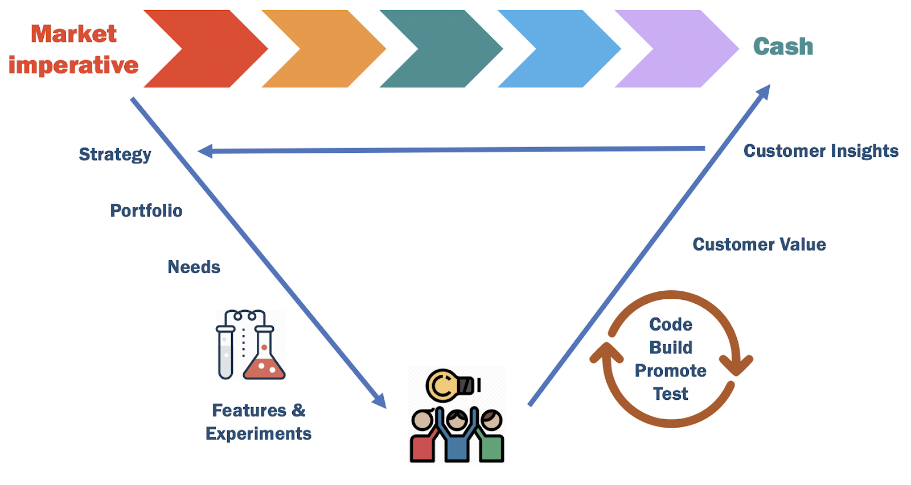

Slide 42
Thank you!
@EstebanFGarcia
@HeidiAraya

